Slide 1
Hygge
A website for chilling

Slide 2
Project blurb & MVC Architecture
A website for students by students, made specifically to relax.
ONI ADD TYPED VERSION OF MVC

Slide 3
UML Diagrams
Class Diagram and Sequence Diagram
ONI INSERT TYPED PICS

Slide 4

Domain Driven Design

Slide 5
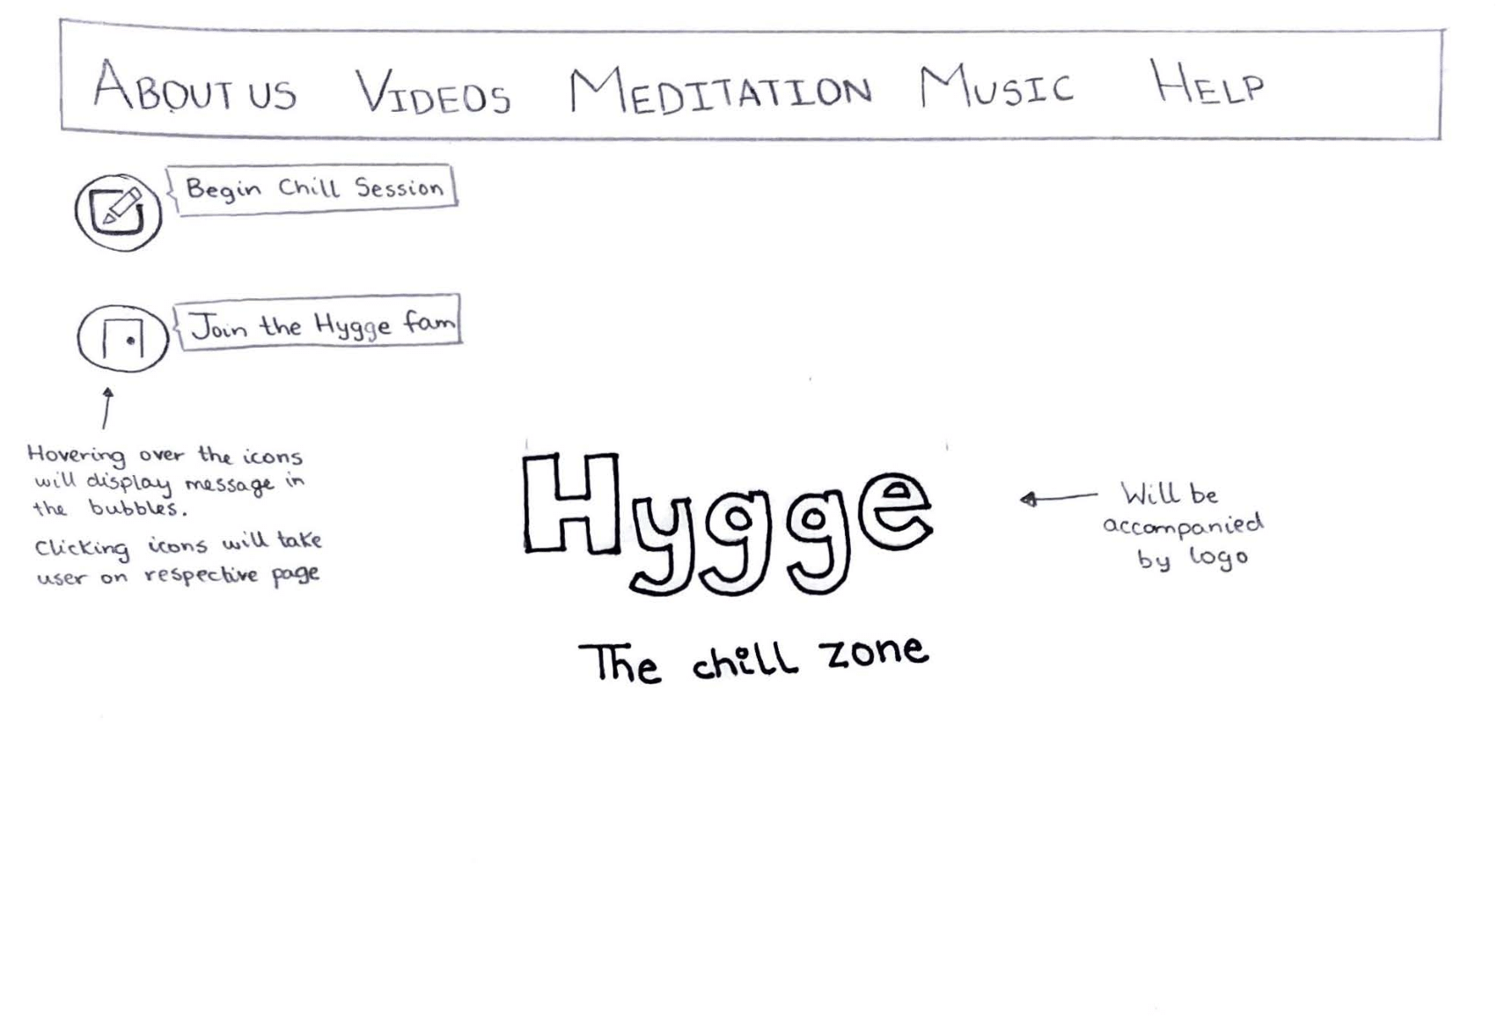
Lo-fidelity Prototype
Simple, clean look for website
As clutter free as possible
White & Black with pops of pastel

Slide 6
Requirements & Kanban
Created and updated our FRD
ONI ADD KANBAN AND GITHUB STUFF

Slide 7
Github
Our github file structure was updated
Easier to understand
ONI ADD PICS

Slide 8
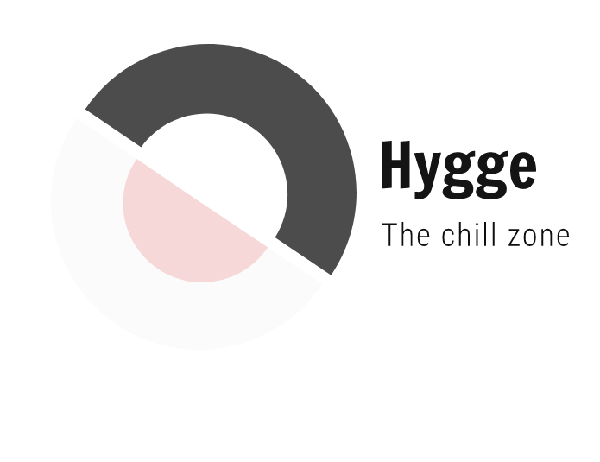
Miscellaneous
We decided on the following logo for our project

Slide 9

Group Reflection
Lofi prototype was a great way to map out website’s interface
Functional requirements document
Everyone must pull their weight
Be understanding of everyone’s situations
Need more clarity and examples on diagrams/functional requirements

